Slide 1
Chapter 8 File organization and indexing
Presented by : Er. Lali Manandhar
Assistant Senior Lecturer
Everest Engineering College

Slide 2
Introduction
A collection of data or information that has a name, called the filename.
Almost all information stored in a computer must be in a file.
There are many different types of files: data files, text files, program files, directory files, and so on.
The physical or internal level of organization of a database system is concerned with the efficient storage of information in the secondary storage device.
The basic problem in the physical database representation is to select suitable file system to store the desired information.
The file consists of records and records may consists of several fields.

Slide 3
The basic file operations that can be performed on file are
1. Creation of file
Before creating a file, we have to collect data, process the data to give it a record like structure. Then we choose a name for the file and open the file on secondary storage device and store the collected data on it.
2. Reading a file
After creating a file, it is needed at any time that we have to read file. We may have to read a particular record or the whole file.
3. Update of a file
Update of a file means that we have to perform some changes on the content of file.

Slide 4
4. Insertion in file
It is required to insert a record or set of records at some specific location.
5. Delete
When some record is not required in the file, then we delete that record to free up the memory.

Slide 5
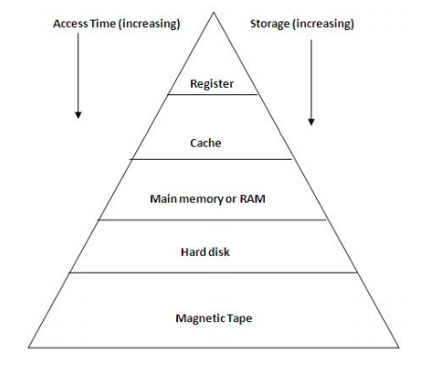
Overview of storage Device
A computer storage device is any type of hardware that stores data.
A typical hierarchy is illustrated below.
As we go down the hierarchy, the following occurs.
1. Decreasing cost per bit.
2. Increasing capacity.
3. Increasing access time.
4. Decreasing frequency of access of the memory by the processor.
Thus, smaller, more expensive and faster memories are supplemented by larger, cheaper and slower memories.

Slide 6
Computer memory can be classified in the below given hierarchy:
1) Internal register:
Internal register in a CPU is used for holding variables and temporary results.
Internal registers have a very small storage; however they can be accessed instantly.
Accessing data from the internal register is the fastest way to access memory.

Slide 7
2) Cache:
Cache is used by the CPU for memory which is being accessed over and over again.
Instead of pulling it every time from the main memory, it is put in cache for fast access.
It is also a smaller memory, however, larger than internal register.
Cache is further classified to L1, L2 and L3:
a. L1 cache: It is accessed without any delay.
b. L2 cache: It takes more clock cycles to access than L1 cache.
c. L3 cache: It takes more clock cycles to access than L2 cache.

Slide 8
3) Main memory or RAM (Random Access Memory):
It is a type of the computer memory and is a hardware component.
It can be increased provided the operating system can handle it.
It is accessed slowly as compared to cache.
They are volatile i.e. content of memory are usually loss in case of power failure or crash.

Slide 9
4) Hard disk:
A hard disk is a hardware component in a computer. Data is kept permanently in this memory.
Memory from hard disk is not directly accessed by the CPU, hence it is slower.
As compared with RAM, hard disk is cheaper per bit. Typically, the entire database is stored on disk.
Data must be moved from disk to main memory in order for data to be processed.

Slide 10
5) Magnetic tape:
Magnetic tape memory is usually used for backing up large data.
When the system needs to access a tape, it is first mounted to access the data. When the data is accessed, it is then unmounted.
The memory access time is slower in magnetic tape and it usually takes few minutes to access a tape.

Slide 11
Organization of Records into Block
A file is organized logically as a sequence of records. Records are mapped onto disk blocks.
Files are provided as a basic construct in operating systems, so we assume the existence of an underlying file system.
Blocks are of a fixed size determined by the operating system.
Record sizes vary. In relational database, tuples of distinct relations may be of different sizes.
There are two approaches of organization of records into block.

Slide 12
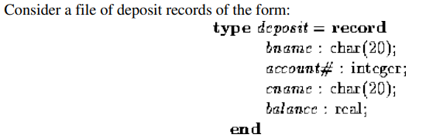
1. Fixed length records

Slide 13
If we assume that each character occupies one byte, an integer occupies 4 bytes, and a real 8 bytes, our deposit record is 52 bytes long.
The simplest approach is to use the first 52 bytes for the first record, the next 52 bytes for the second, and so on.
However, there are two problems with this approach.
It is difficult to delete a record from this structure. Space occupied by the records to be deleted must be filled with some other records of the file. When a record is deleted, we could move all successive records up one, which may require moving a lot of records.
Some records will cross block boundaries. It would then require two block accesses to read or write such a record.

Slide 14
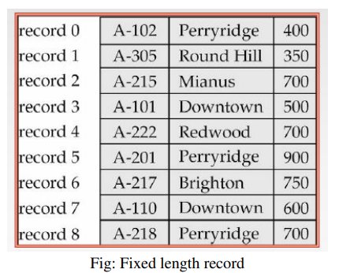
Use of pointers requires careful programming.
If a record pointed to is moved or deleted, and that pointer is not corrected, the pointer becomes a dangling pointer.

Slide 15
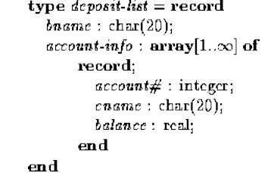
2. Variable length records
Variable-length records arise in a database in several ways:
Storage of multiple record types in a file
Record types allowing variable field size
Record types allowing repeating fields
One example with a variable-length record:

Slide 16
Account-information is an array with an arbitrary number of elements i.e. the type definition does not limit the number of elements in the array.
So there is no limit on how large a record can be.
The space available for the records must be managed carefully.
To manage free space, there is a pointer that indicates the start of the free space area.

Slide 17
There are two approaches for variable length record
1. Byte-String representation
2. Fixed length representation

Slide 18
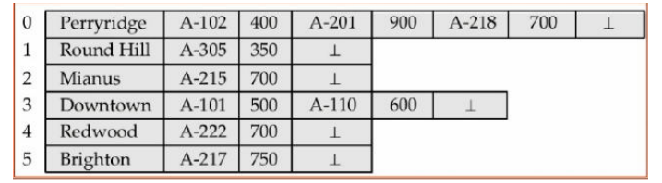
1. Byte-String Representation
Byte string representation uses the technique of attaching a special end-of-record symbol to the end of each record.
Then we can store each record as a string of successive bytes.

Slide 19
Byte string representation has several disadvantages:
It is not easy to re-use space left by a deleted record
There is no space for records to grow longer, so if the record become longer it must be moved.
A large number of small fragments of disk storage are wasted.

Slide 20
2. Fixed Length Representation
Fixed-length representation uses one or more fixed-length records to represent one variable-length record.
Two techniques:
a. Reserved space –
uses fixed-length records large enough to accommodate the largest variable-length record.
If the length of record is shorter and space is unused, it is filled with a null or symbol.
The main problem associated with this technique is space is wasted.

Slide 21
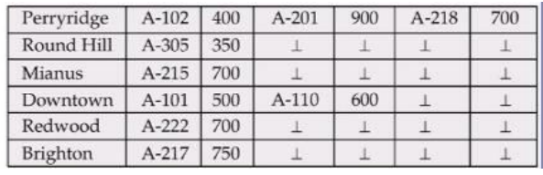

Slide 22
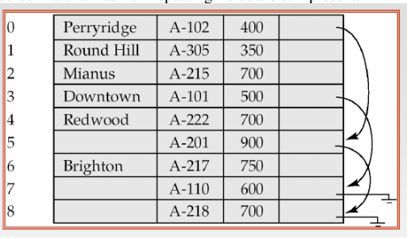
b. Pointers –
represent by a list of fixed-length records, chained together via pointer.
It can be used even if the maximum record length is not known.
The problem is that space is wasted in successive records in a chain as non-repeating fields are still present.

Slide 23
Buffer Management
We need to use disk storage for the database, and to transfer blocks of data between MM and disk.
We also want to minimize the number of such transfers, as they are time-consuming.
One way is to keep as many blocks as possible in MM. Usually, we cannot keep all blocks in MM, so we need to manage the allocation of available MM space.
The buffer is the part of MM available for storage of copies of disk blocks.
The subsystem responsible for the allocation of buffer space is called the buffer manager.
The buffer manager handles all requests for blocks of the database.
Notes:
MM – Main memory

Slide 24
If the block is already in MM, the address in MM is given to the requestor.
If not, the buffer manager must read the block in from disk (possibly displacing some other block if the buffer is full) and then pass the address in MM to the requestor.
The buffer manager must use some sophisticated techniques in order to provide good service:
1. Replacement Strategy –
When there is no room left in the buffer, some block must be removed to make way for the new one.
Typical operating system memory management schemes use a ``least recently used'' (LRU) method.

Slide 25
2. Pinned Blocks –
For the database to be able to recover from crashes, we need to restrict times when a block maybe written back to disk.
A block not allowed to be written is said to be pinned.
Many operating systems do not provide support for pinned blocks, and such a feature is essential if a database is to be ``crash resistant''.
3. Forced Output of Blocks –
Sometimes it is necessary to write a block back to disk even though its buffer space is not needed. (Called the forced output of a block.)
This is due to the fact that MM contents (and thus the buffer) are lost in a crash, while disk data usually survives.

Slide 26
Data Dictionary Storage
The database also needs to store information about the relations, known as the data dictionary.
This information is called data dictionary or system catalog.
Some of the types of information the system must store are given below.
1. Names of relations.
Names of attributes of relations.
Domains of attributes.
Names and definitions of views.
Integrity constraints (e.g. key constraints).
Notes:
MM – Main memory

Slide 27
2. Data on the system users:
Names of authorized users including passwords or other information used to authenticate users
Accounting information about users.
3. Statistical and descriptive data
Number of tuples in each relation.
4. Physical file organization
How relation is stored (Sequential/ hash / Heap)
Physical location of relation
Information about indices (Name of index, types index formed, attribute on which the index is defined).

Slide 28
File Organization
A file is a sequence of records stored in binary format.
A disk drive is formatted into several blocks that can store records.
File records are mapped onto those disk blocks.
File Organization defines how file records are mapped onto disk blocks.
We have four types of File Organization to organize file records.
1. Heap (Pile) file organization
2. Sequential file organization
3. Indexed Sequential file organization
4. Hash file organization
Notes:
MM – Main memory

Slide 29
1. Heap file organization
In a heap or pile file, records are collected in the order they arrive.
The block used in heap are linked by pointers.
Any records can be placed anywhere in the file where there is space for the records.
There is no ordering/ sorting of the records.
When a new record is to be inserted it is placed in the last block if there is space.
If the last block can not accommodate that records, a new block is allocated and the records to be inserted is placed.
The time required to locate a records in a heap is time consuming if the file is spread over more than few blocks.
Notes:
MM – Main memory

Slide 30
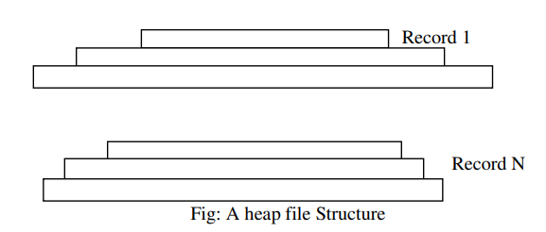
The heap file organization is generally used for small files.

Slide 31
Advantage:
Very good method of file organization for bulk insertion
It is suited for very small files as the fetching of records is faster in them.
Disadvantage
This method is inefficient for larger databases as it takes time to search/modify the record
Proper memory management is required to boost the performance.
Otherwise there would be lots of unused memory blocks lying and memory size will simply be growing.

Slide 32
2. Sequential file organization
A sequential file is designed for efficient processing of records in sorted order based on some search key.
In a sequential file organization records are placed sequentially onto the storage media.
A search key is a attribute or set of attributes, but it need not to be a primary key.
In addition, the records in the file are usually order according to the values of key attributes.
To permit fast retrieval of records in search key order, we chain together records by pointers.
The pointer in each record point to the next record in search key order.
Notes:
MM – Main memory

Slide 33
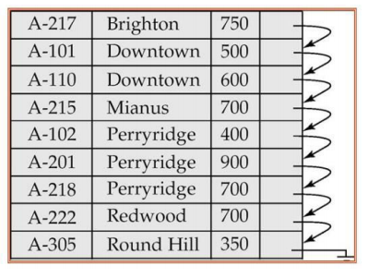
In the figure below, all the records are stored in search key order using branch name as search key.

Slide 34
Advantage:
The design is very simple compared other file organization.
Searching and deletion operation is faster as compared to heap file organization.
This method is good in case of report generation or statistical calculations.
These files can be stored in magnetic tapes which are comparatively cheap.
Disadvantage
This method always involves the effort for sorting the record. Each time any insert/update/ delete transaction is performed, file must be sorted.

Slide 35
Indexed sequential access method (ISAM)
ISAM method is an advanced sequential file organization.
In this method, records are stored in the file using the primary key.
An index value is generated for each primary key and mapped with the record.
This index contains the address of the record in the file.
If any record has to be retrieved based on its index value, then the address of the data block is fetched and the record is retrieved from the memory.
Notes:
MM – Main memory

Slide 36
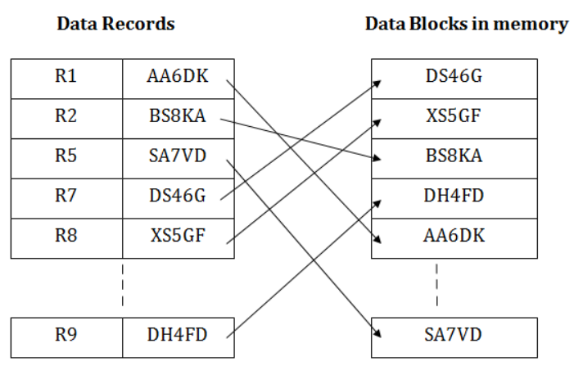

Slide 37
Advantage:
In this method, each record has the address of its data block, searching a record in a huge database is quick and easy.
This method supports range retrieval and partial retrieval of records. Since the index is based on the primary key values, we can retrieve the data for the given range of value. In the same way, the partial value can also be easily searched, i.e., the student name starting with 'JA' can be easily searched.

Slide 38
Disadvantage:
This method requires extra space in the disk to store the index value.
When the new records are inserted, then these files have to be reconstructed to maintain the sequence.
When the record is deleted, then the space used by it needs to be released. Otherwise, the performance of the database will slow down.

Slide 39
B+ tree index file
The main disadvantage of index sequential file organization are that performance degrades as the file size grow.
Although this degradation can be reduced by reorganization of file, but it requires periodic reorganization of entire file.
B+ tree file structure maintains the efficient tree as it automatically reorganizes itself after every insertion and deletion.
Notes:
MM – Main memory

Slide 40
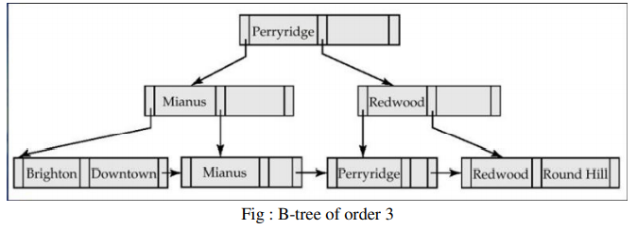
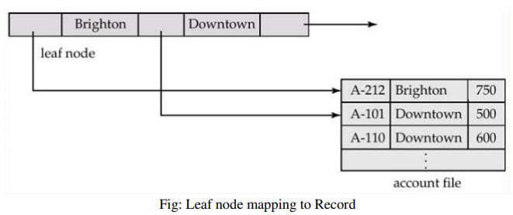

Slide 41
Properties:
In B+ tree, leaf nodes denotes actual data pointers
It is also called as balanced tree as all the leaf node are at same level.
The leaf nodes are linked using linked list
All the non leaf node has one fewer key than the number of its children.
Maximum no of key per node of M order tree = M-1 nodes
Minimum no of key per node of M order tree =(˹M/2˺ -1)nodes
Maximum no of pointer per node of M order tree = M
Minimum no of pointer per node of M order tree = ˹M/2˺

Slide 42
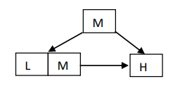
Insertion in B+ Tree
Traverse B-tree until we find leaf node suitable for insertion.
We have two cases for inserting a key.
i. Node is not full
- Insertion is done in the node in increasing order of key
ii. Node is full
a. If a node is full and is a leaf, classify the keys L(Lowest), M(Middle) and H(Highest) and split the node as below.
Notes:
MM – Main memory

Slide 43
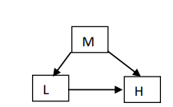
b. If a node is full and is non leaf, classify the keys L(Lowest), M(Middle) and H(Highest) and split the node as below.
The median value (M) is pushed one level up in the parent node. If the parent node is not full then accommodate the median value otherwise repeat same procedure in case II.

Slide 44
Example:
Construct B+ tree of order 3 for the following set of keys. 5 ,15, 25,30,45,60,18,28
Construct B+ tree of order 4 for the following set of keys. 1,4,7,10,17,21,31,25,19,20,28
Refer your DSA note

Slide 45
Hash Indices
A hash index organizes the search keys with their associated pointers into a hash file structure.
We apply a hash function on a search key to identify a bucket, and store the key and its associated pointers in the bucket (or in overflow buckets).
A hash function, h(K), is a mapping function that maps all the set of search-keys K to the bucket where keys and its associated pointers are placed.
Notes:
MM – Main memory

Slide 46
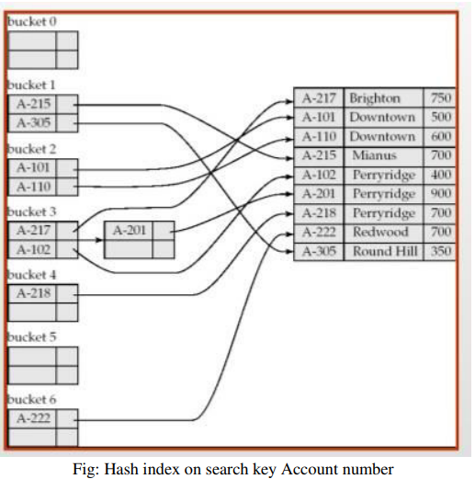
The hash function in the above function is
H(K)= Sum of the digits of account number % 7
The hash index has 7 buckets each size 2. One of the bucket has 3 keys mapped so it has an overflow bucket.

Slide 47
Formally let K denote the set of all search keys value, B denote the set of all bucket address and h denote the hash function.
To insert a record with search key ki , we compute h(Ki) which gives the address of bucket for that record.
That record is then stored in that bucket.
Deletion is also simple. If the search key value of the record to be deleted is Ki.
We compute h(ki) to find the corresponding bucket for that record and delete the record from the bucket.

Slide 48
Handling bucket overflow
If the bucket doesn’t have enough space to store the currently hashed key value, a bucket overflow is said to occur.
Bucket overflow can occur for the following reasons.
i. Insufficient Buckets
ii. Skew: Some bucket are assigned more records than others so bucket may overflow even when other bucket have space. This situation is called bucket skew.
The worst possible hash function maps all search key values to same bucket.
Such a hash function is undesirable because all the records have to be kept in same bucket.
Notes:
MM – Main memory

Slide 49
An ideal hash function distributes the stored key uniformly across the buckets so that every bucket has the same number of records.
We handle bucket overflow by using overflow buckets.
If a record must be inserted in bucket b and bucket b is already full, the system provides overflow bucket for b and insert the record into the overflow bucket as shown in above figure.
If the overflow bucket is also full then the system provides another overflow bucket and so on.
All the overflow buckets of the given bucket are chained together in a linked list.
This kind of overflow handling technique is called as overflow chaining.

